Slide 1
Comparison of Octahedral and Tetrahedral Fields

Slide 2
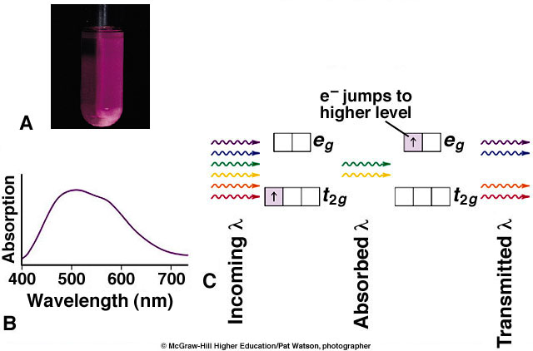
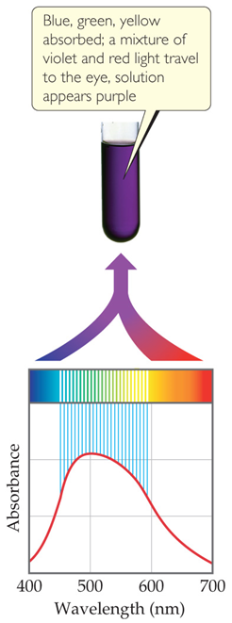
Determination of Δ
[Ti(H₂O)₆]³⁺

Slide 3
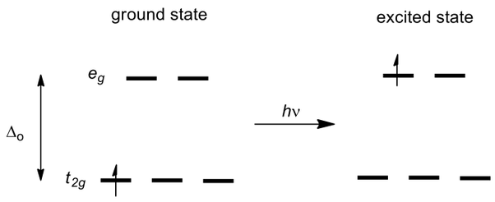
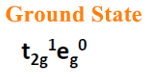
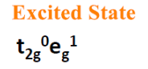
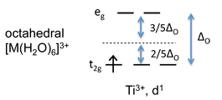
Determination of Δ
[Ti(H₂O)₆]³⁺ is a d¹ complex. The single electron in the t_{2g} orbitals absorb energy in the form of light and gets promoted to the e_{g} orbitals to show it’s purple color.
For [Ti(H₂O)₆]³⁺, this corresponds to 493 nm (Δ_{o} = 20,300 cm⁻¹ = 243 kJ/mol).
For t_{2g}¹e_{g}⁰ configuration:
stabilization energy = 243 x 0.4 = 97 kJ/mol,
this extra stabilization due to the splitting of d-orbitals called
crystal field stabilization energy (CFSE).

Slide 4
Factors Influencing the Magnitude of Δ

Slide 5
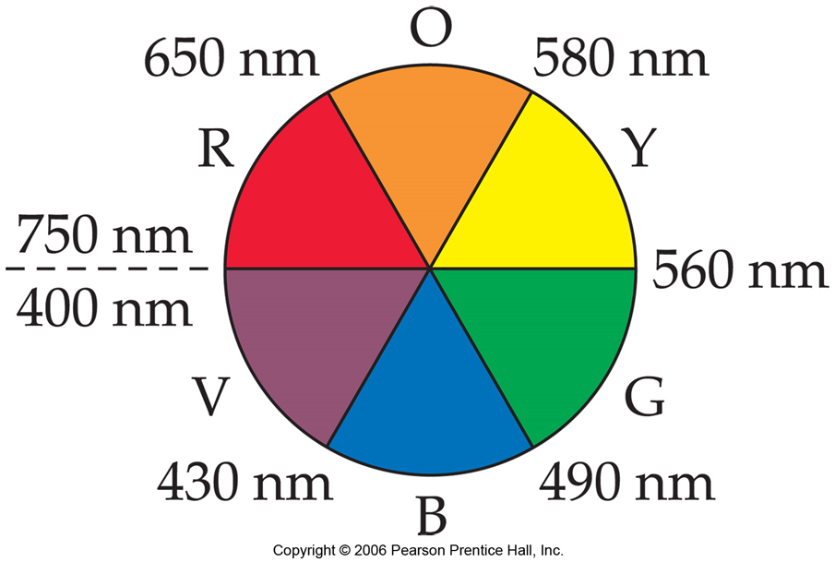
Δ is Relatable to Colour
Complementary colour wheel.
Absorb Orange See Blue
Absorb Red See Green

Slide 6
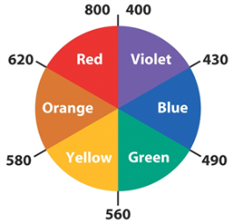
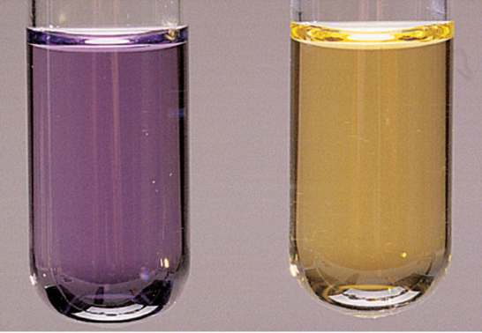
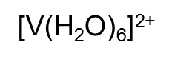
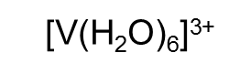
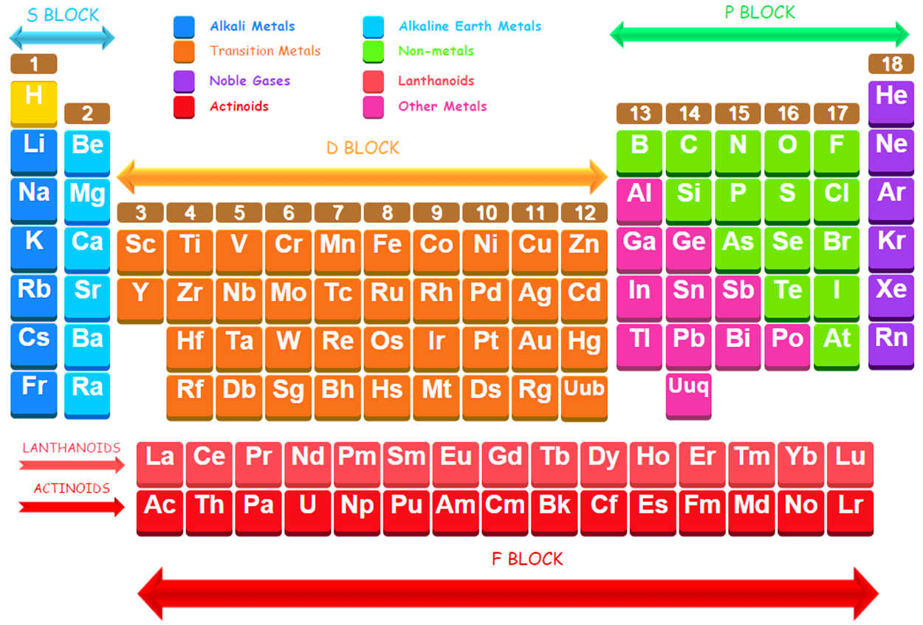
Factors Influencing the Magnitude of Δ
1. Higher oxidation states of the metal atom correspond to larger Δ.
Δ = 10,200 cm⁻¹ for [Co^{II}(NH3)6]²⁺ and 22,870 cm⁻¹ for [Co^{III}(NH3)6]³⁺
Δ = 32,200 cm⁻¹ for [Fe^{II}(CN)6]⁴⁻ and 35,000 cm⁻¹ for [Fe^{III}(CN)6]³⁻
Higher ionic charge on the metal ion, pulls the ligands closer
towards it and higher electrostatic repulsion results in larger
splitting of d-orbitals
2. In groups, heavier analogues have larger Δ.
For hexaammine complexes
[M^{III}(NH₃)₆]³⁺: Δ = 22,870 cm⁻¹ (Co)
34,100 cm-1(Rh)
41,200 cm-1(Ir)
Larger size of 4d and 5d orbitals results in stronger interactions
with ligands.
For larger metal ion, the ligands experience less steric crowding and
thus approach closer. Thus results in stronger interaction and larger
crystal field splitting.

Slide 7
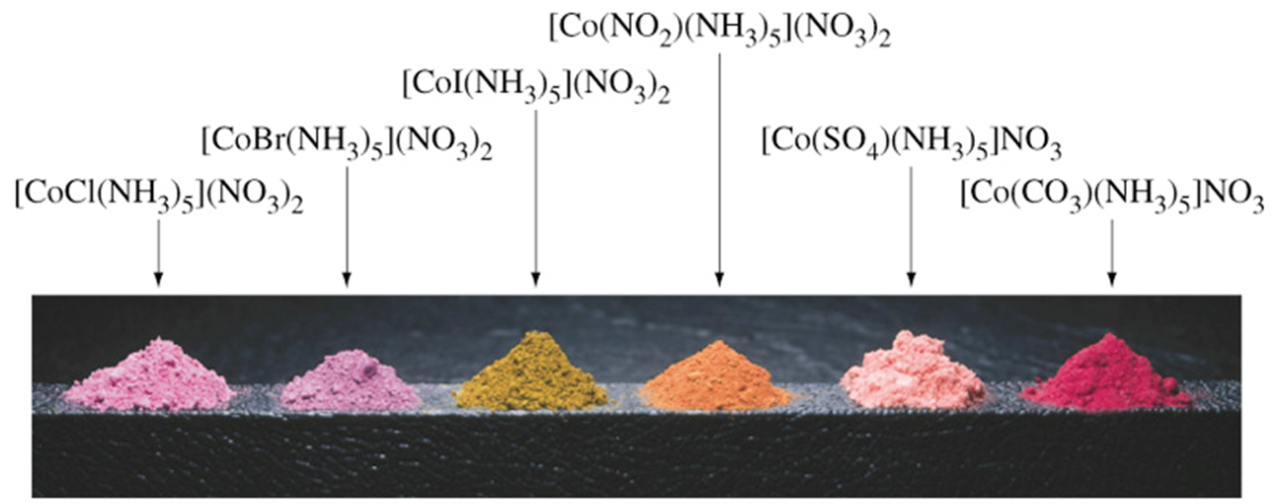
Factors Influencing the Magnitude of Δ
3. Coordination number/ Geometry has significant effect on Δ.
Tetrahedral complexes ML₄ have smaller Δ than octahedral ones (ML₆):
Δ = 10,200 cm⁻¹ for [Co^{II}(NH₃)₆]²⁺
5,900 cm⁻¹ for [Co^{II}(NH₃)₄]²⁺
4. Nature of the ligands.

Slide 8
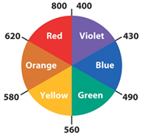
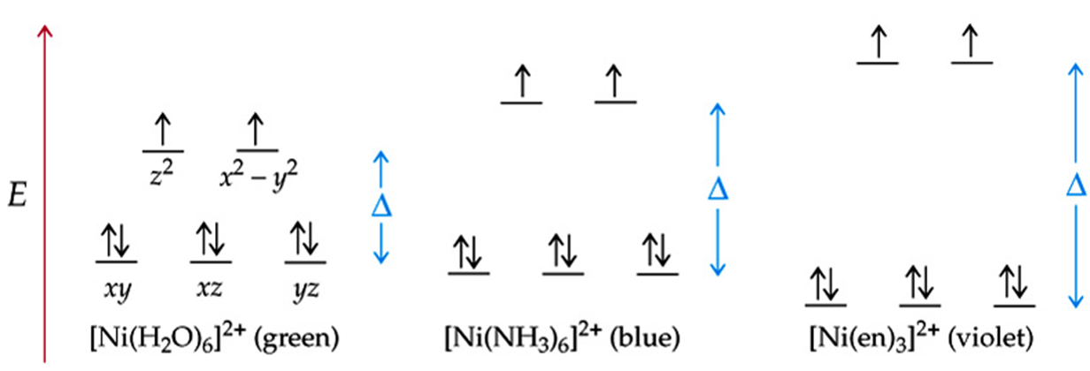
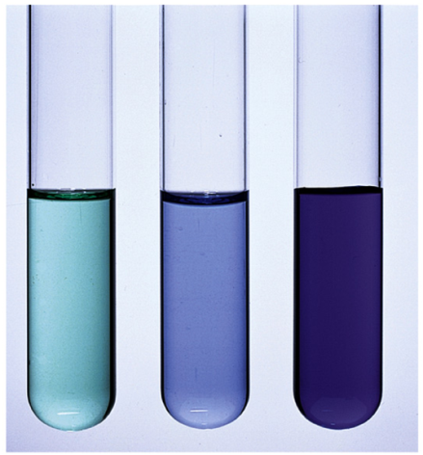
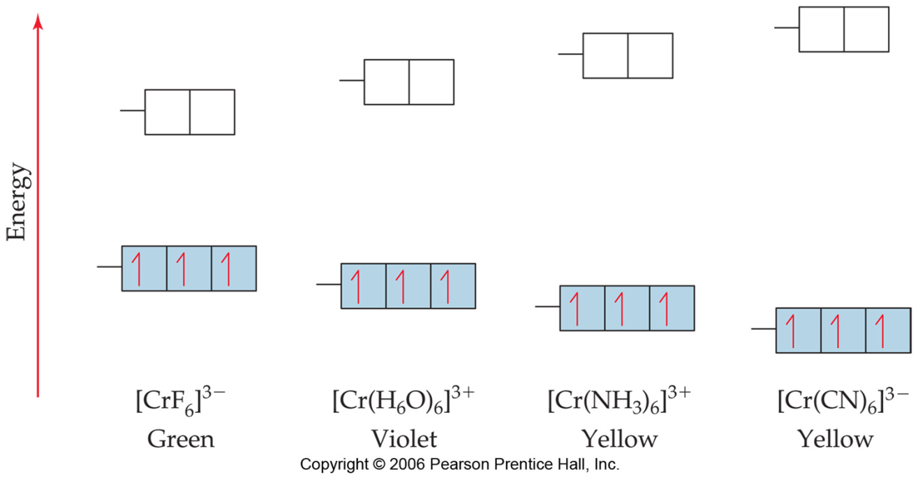
Effect of Ligands on the Magnitude of Δ
Example nickel complexes
Example chromium complexes

Slide 9
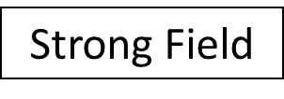
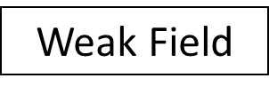
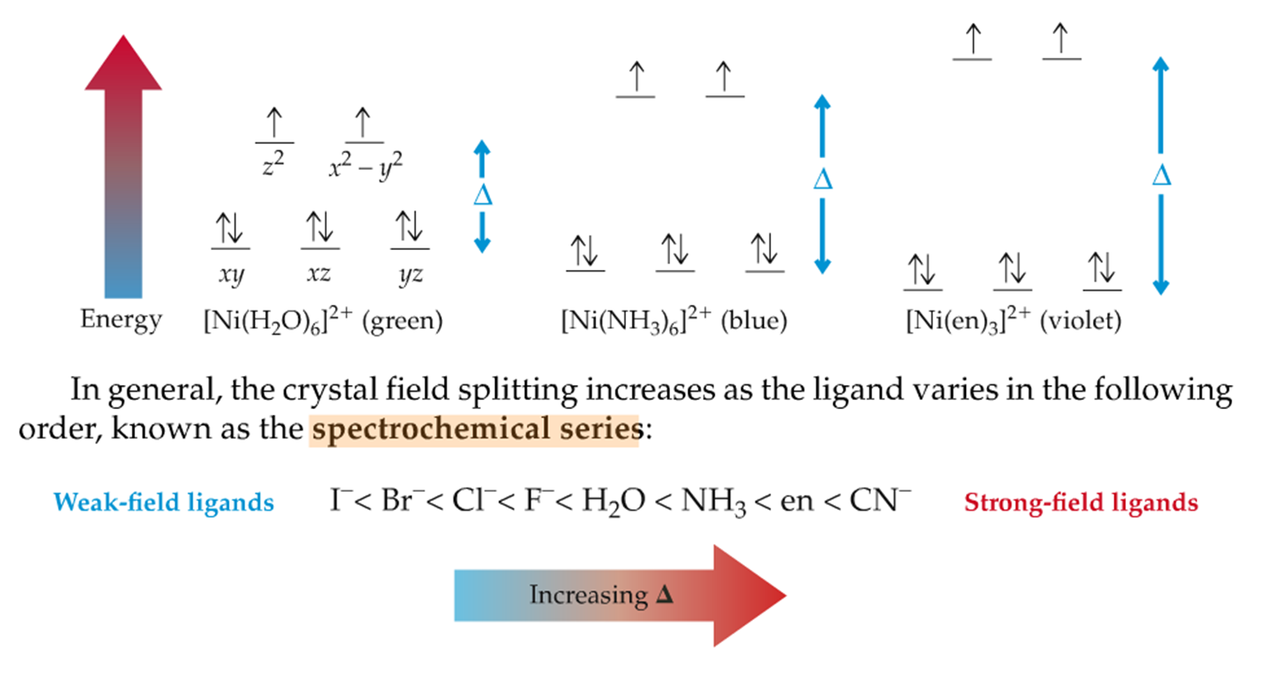
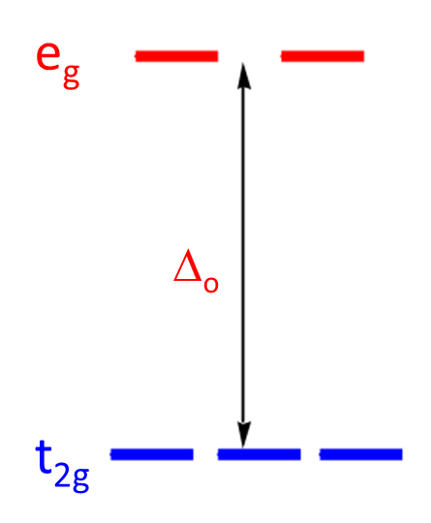
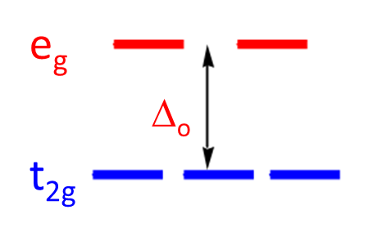
Effect of Ligands on Δ: Spectrochemical Series
An arrangement of ligands according to their increasing ability to split the
d-orbitals or crystal field splitting parameter (Δ).
Experimentally determined.
Weak Field
I⁻ < Br⁻< S²⁻< SCN⁻< Cl⁻< NO₃⁻< F⁻ < C₂O₄²⁻< H₂O< NCS⁻< CH₃CN< NH₃< en < bipy< phen< NO₂⁻< PPh₃< CN⁻< CO
Strong Field

Slide 10
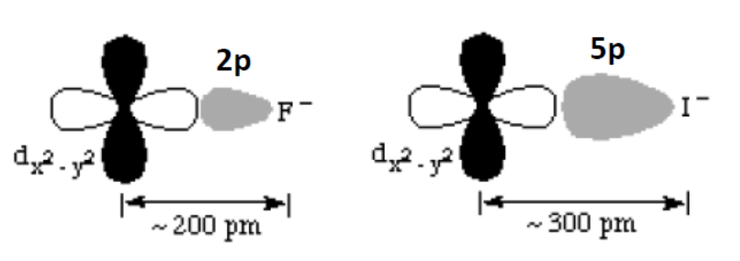
Analysis of the Spectrochemical Series
Spectrochemical Series cannot be entirely explained by Crystal Field Theory (CFT).
Examples: why neutral molecules such as H₂O are stronger ligands than halides; why
PPh₃ and CO are strong field ligands.
Orbital interactions need to be invoked to rationalize the order of ligands. Thus,
covalency is incorporated into CFT resulting in the Ligand Field Theory.
We will not discuss detailed Molecular Orbital treatment but will focus on Ligand Field Theory as a tool to understand important concepts pertaining to the bonding in coordination compounds.
Observation: I⁻ < Br⁻< Cl⁻< F⁻ (Ligand Field strength)
In terms of CFT, the fluoride ion being much smaller, can approach closer
to the metal ion thereby increasing the electronic repulsion leading to higher Δ.

Slide 11
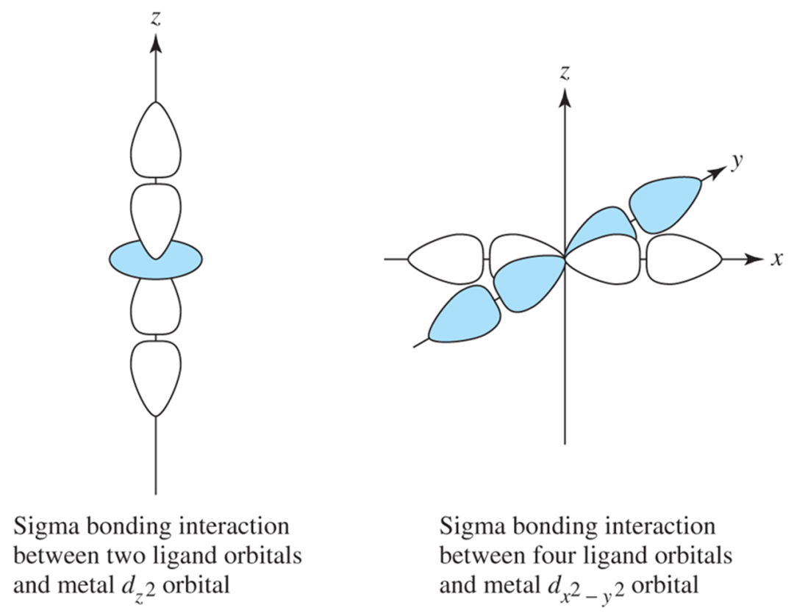
Analysis of the Spectrochemical Series
Observation: F⁻ < OH⁻< O²⁻< H₂O (Ligand Field strength)
To explain the above series, let’s look at the bonding modes between the ligand and the metal. We will consider simplified diagrams for clarity.
Initially, the ligands can be viewed as having a hybrid orbital or a p orbital pointing toward the metal to make σ bonds.
This is referred to as σ donation from the ligand to the metal.
Hence, all ligands are “σ donors”.
However, some ligands may have additional orbitals that can interact with other orbitals on the metal.
Ligand Field Theory provides insights into these additional interactions as the reasons for the different strengths of ligands.

Slide 12
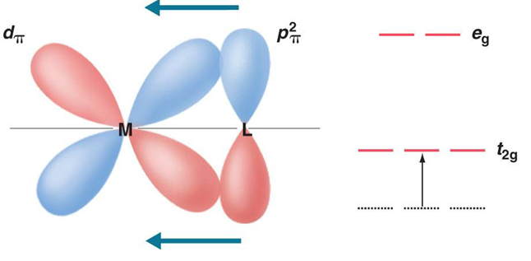
Analysis of the Spectrochemical Series
Observation: F⁻ < OH⁻< O²⁻< H₂O (Ligand Field strength)
Ligands which have filled p orbitals may act as π donors by interacting with suitable metal orbitals.
Interaction between d_{xy} of metal and p_{y} of halide:
Reduces positive charge on metal
Reduces Δ
Water acts only as a sigma-donor ligand.

Slide 13
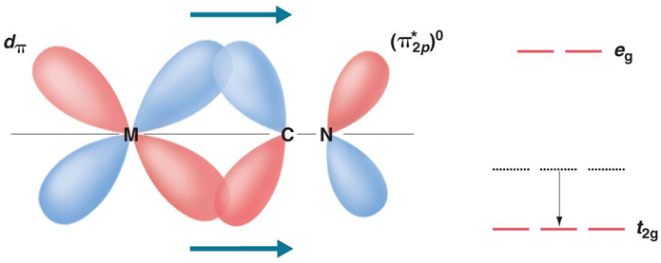
Analysis of the Spectrochemical Series
Observation: PPh₃, CN⁻, CO are strong field ligands
Ligands which have empty p or d orbitals may act as π acceptors by interacting with suitable metal orbitals.
-back-bonding of ligand with d_{xy} orbital Increases positive charge on metal
Increases Δ
dπ-pπ back donation (back bonding)

Slide 14
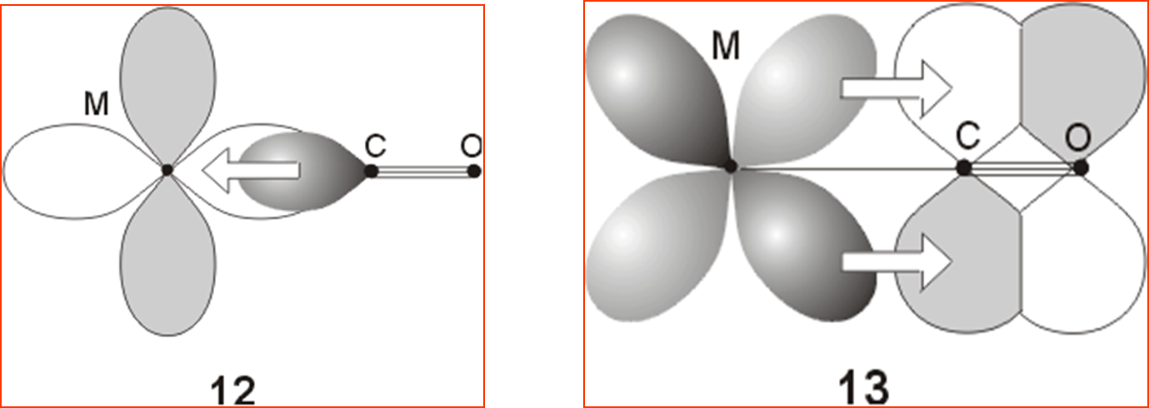
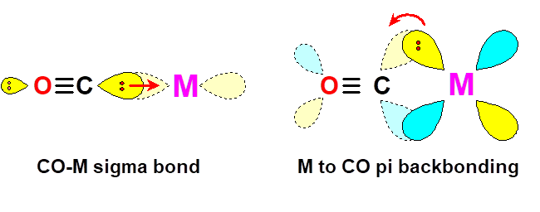
Analysis of the Spectrochemical Series
CO also has available π* orbitals for back bonding.

Slide 15
Analysis of the Spectrochemical Series
PPh₃ has dπ orbitals for back bonding.
Accepts electrons from filled metal d-orbital to empty d-orbital of P in PPh₃ (π-back bonding)
In low oxidation states, the electron density on the metal ion is very high.
To stabilize low oxidation states, we require ligands, which can simultaneously bind the metal center and also withdraw electron density from it.

Slide 16
Summary of Ligand Bonding Modes
1. All ligands are σ donors. In general, ligands that engage solely in σ bonding are in the middle of the spectrochemical series.
Ligands with filled p or d orbitals can also serve as π donors. This results in a smaller value of ∆_{o}.
3. Ligands with empty p, d or π* orbitals can also serve as π acceptors. This results in a larger value of ∆_{o}.
I⁻<Br⁻<Cl⁻<F⁻<H₂O<NH₃<PPh₃<CO
π donor< weak π donor<σ only< π acceptor
Examples of donor and acceptor ligands
Sigma donor | Pi donor* | Pi acceptor*
H₂O NR₃ | RO⁻, R₂N⁻ F⁻, Cl⁻ RCOO⁻ | CO, olefin CN⁻ PR₃
These ligands also act as σ donors.

Slide 17
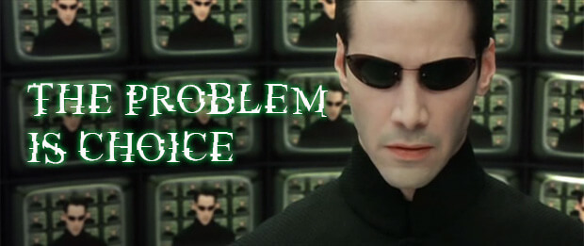
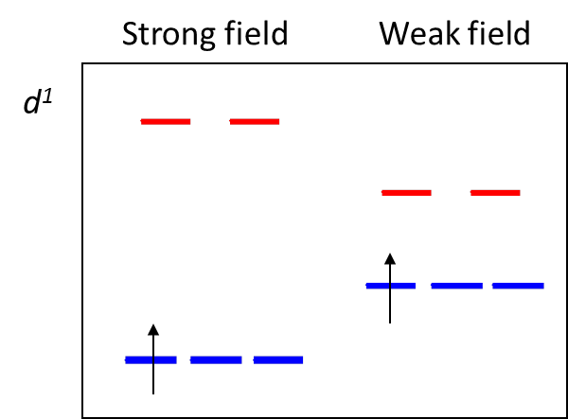
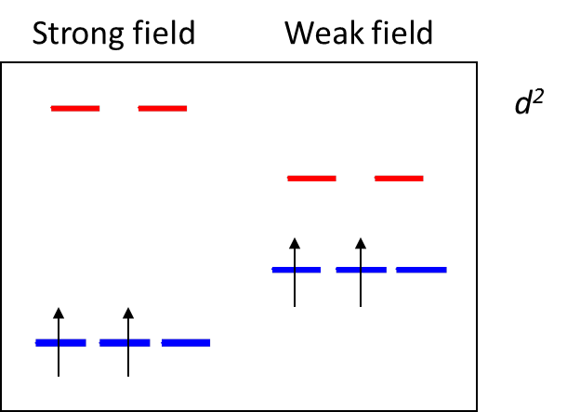

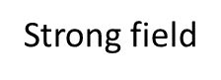
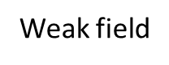
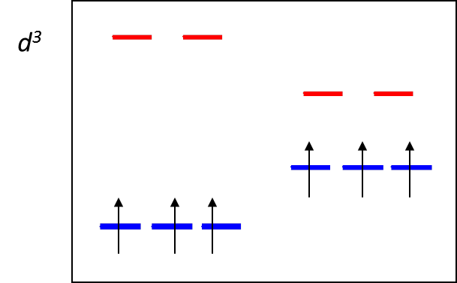
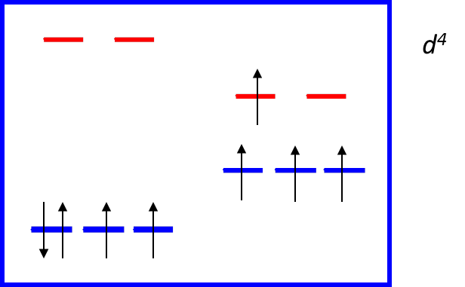
Significance of Spectrochemical Series
Lets try to populate the t_{2g} and e_{g} orbitals for octahedral complexes of different metals (varying number of d-electrons).
d¹-system: no impact of strong field
or weak field ligand (t_{2g}³ configuration)
d²-system: no impact of strong field
or weak field ligand (t_{2g}³ configuration)
d³-system: no impact of strong field
or weak field ligand (t_{2g}³ configuration)
d⁴-system: Two choices depending on the ligand

Slide 18
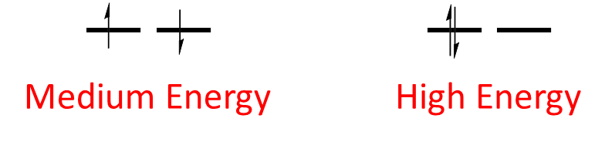
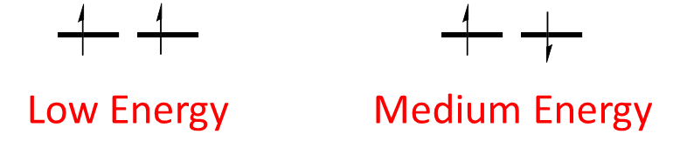
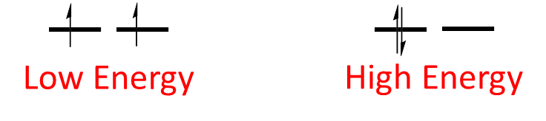
To Pair or Not? Pairing Energy (Π) Decides
The pairing energy, P, depends only on the metal, and is made up of two parts.
1. Coulombic repulsion energy caused by having two electrons in same orbital. Destabilizing energy contribution of Π_{c} for each doubly occupied orbital.
2. Exchange stabilizing energy for each pair of electrons having the same spin and same energy. Stabilizing contribution of Π_{e} for each pair having same spin and same energy.
Π = sum of all Π_{c} and Π_{e} interactions

Slide 19
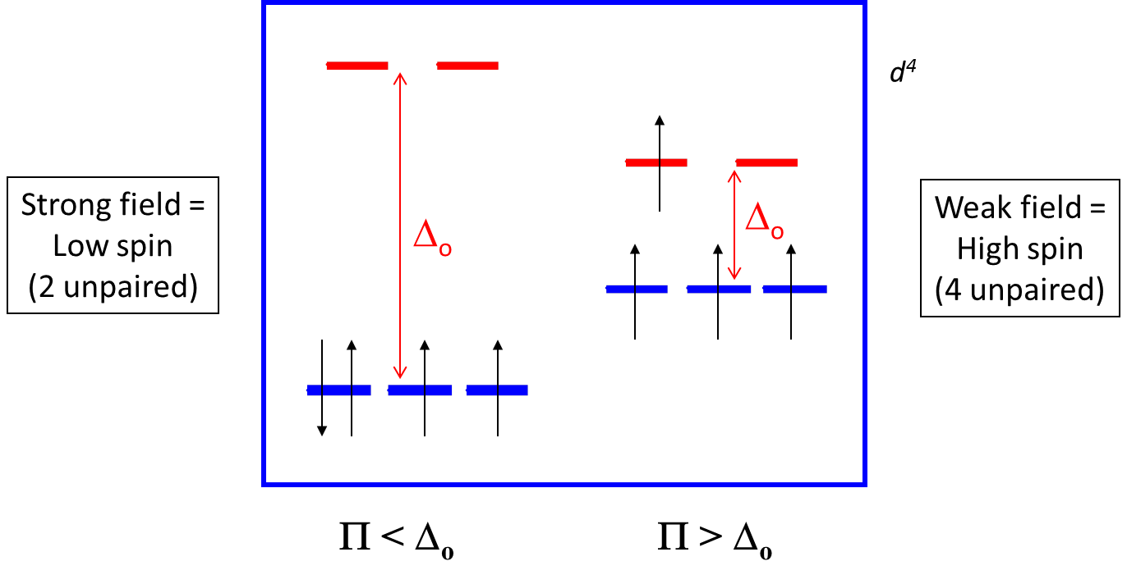

Π vs. Δ_{o}: High Spin and Low Spin Complexes
When the 4th electron will either go into the higher energy e_{g} orbital at an energy cost of Δ_{o} or be paired at an energy cost of Π, the pairing energy.

Slide 20
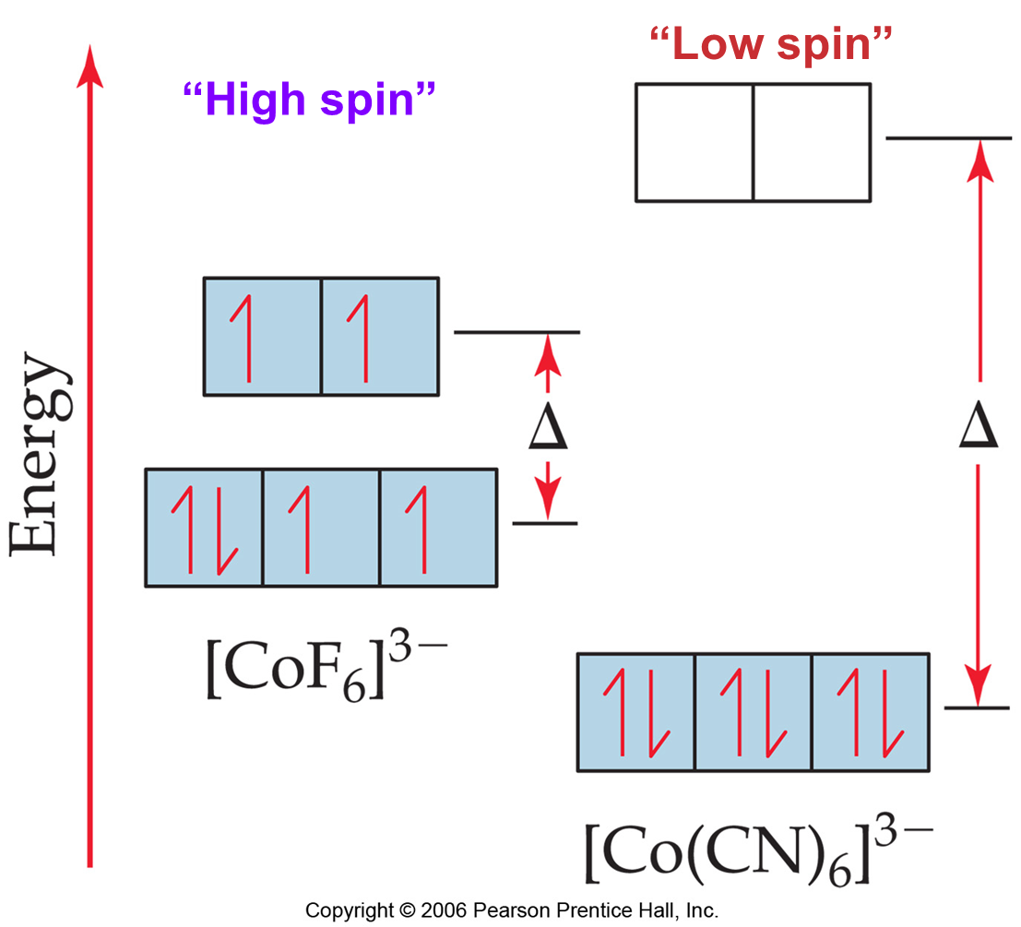
High Spin and Low Spin Complexes: Example
As ligand Changes, electronic configuration also may change (occupancy of t_{2g} and e_{g} orbitals may become different).

Slide 21
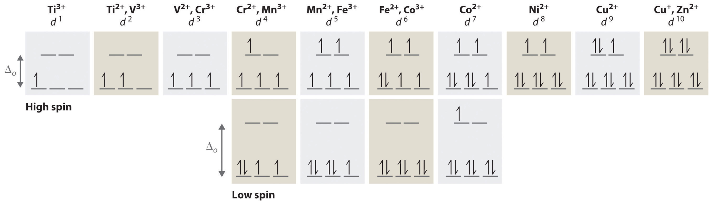
High Spin and Low Spin Complexes
Two different configurations are possible for octahedral complexes of metals with d⁴, d⁵, d⁶, and d⁷ configurations.
For d⁴, d⁵, d⁶, and d⁷ configurations, the magnitude of Δ_{o} determines which configuration is observed.

Slide 22
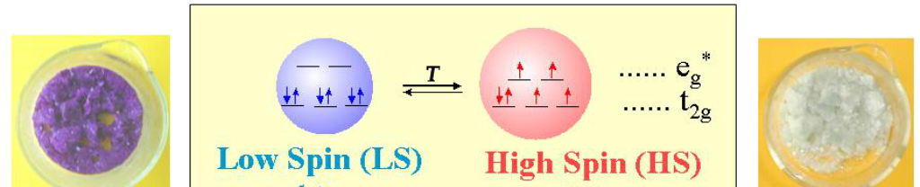
Curiosity: What Happens When Δ_{o} is Close to Π
When Δ_{o} ~ Π , interconversion between high spin and low spin states should be possible
Has been observed for Fe(II)-d⁶ systems. Can be brought about by heat and light

Slide 23

Recap and Some Important Generalizations
Oxidation state of the metal ion
Δ increases with increase in ionic charge
Nature of Metal
3d < 4d < 5d
Really large Δ, normally low spin (As you go down the periodic table, Δ increases)
Number and geometry of ligands
Δ_{tetrahedral} only ~50% of Δ_{octahedral}
3d metals are generally high spin complexes except with very strong ligands. CN⁻ forms low spin complexes, especially with M³⁺ ions.
4d & 5d metals generally have a larger value of ∆_{o} than for 3d metals. As a result, complexes are typically low spin.
For 3d metals, tetrahedral splitting is seldom large enough to result in pairing of the electrons. As a result, low-spin tetrahedral complexes are not common.

Slide 24
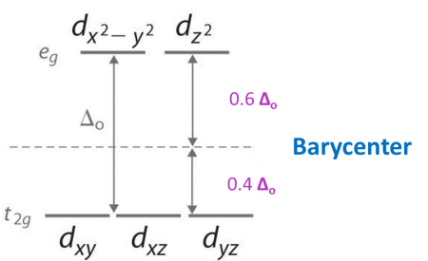
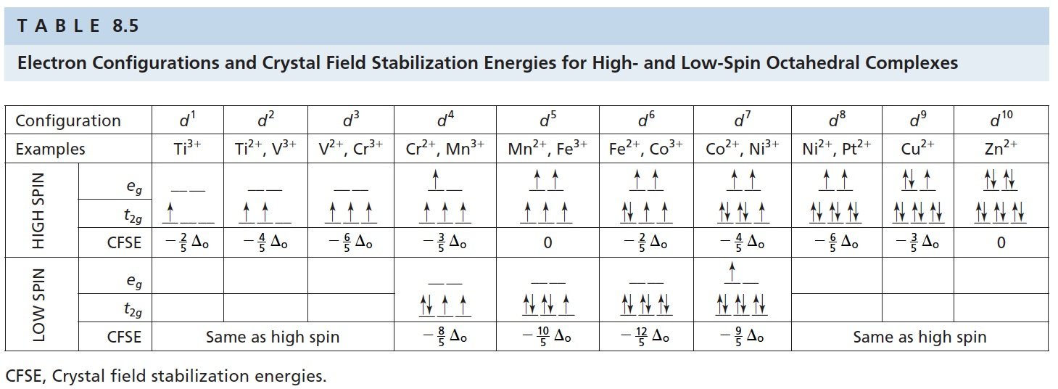
CFSE will Vary for Different Electronic Configurations
CFSE = [-0.4 x n(t_{2g}) + 0.6 x n(e_{g})] Δ_{o}
where n(t_{2g}) and n(e_{g}) are number of electrons in the respective levels
Distribution of electrons and CFSE

Slide 25
Electronic Configurations for Tetrahedral Complexes
Tetrahedral splitting is seldom large enough to result in pairing of the electrons. As a result, low-spin tetrahedral complexes are not common.
d-electrons | configuration | CFSE
d¹ | e¹t₂⁰ | -0.6 Δ_{t}
d² | e²t₂⁰ | -1.2 Δ_{t}
d³ | e²t₂¹ | -0.8 Δ_{t}
d⁴ | e²t₂² | -0.4 Δ_{t}
d⁵ | e²t₂³ | 0.0 Δ_{t}
d⁶ | e³t₂³ | -0.6 Δ_{t}
d⁷ | e⁴t₂³ | -1.2 Δ_{t}
d⁸ | e⁴t₂⁴ | -0.8 Δ_{t}
d⁹ | e⁴t₂⁵ | -0.4 Δ_{t}
d¹⁰ | e⁴t₂⁶ | 0.0 Δ_{t}

Slide 26
Tetrahedral Complexes
If Δ_{t} is smaller than Δ_{o} (Δ_{t} = 4/9 Δ_{o}), why would tetrahedral complexes form?
But what if we take a particular metal ion and a particular ligand? Can we predict whether it will form an octahedral or a tetrahedral complex, for example?
If we make the assumption that Δ_{t} = 4/9 Δ_{o}, we can calculate the difference in stabilization energy between octahedral and tetrahedral geometries by referencing everything in terms of Δ_{o}.
Example Problem:
Which is the preferred configuration for a d³ metal: tetrahedral or octahedral?

Slide 27
Tetrahedral Complexes
To answer this, the Crystal Field Stabilization Energy has to be calculated for a metal in both configurations. The geometry with the greater stabilization will be the preferred geometry.
For a d³ octahedral configuration, the CFSE is 3 x -0.4 Δ_{o} = -1.2 Δ_{o}
For a d³ tetrahedral configuration (assuming high spin), the Crystal Field Stabilization Energy is -0.8 Δ_{t}
Remember that because Δ_{tet} is less than half the size of Δ_{o}, tetrahedral complexes are often high spin. We can now put this in terms of Δ_{o} (we can make this comparison because we're considering the same metal ion and the same ligand: all that's changing is the geometry)
So for tetrahedral d³, the Crystal Field Stabilization Energy is:
CFSE = -0.8 x 4/9 Δ_{o} = -0.355 Δ_{o}.
And the difference in Crystal Field Stabilization Energy between the two geometries will be: 1.2 - 0.355 = 0.845 Δ_{o}.

Slide 28
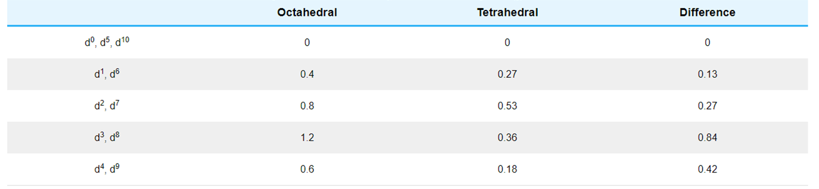
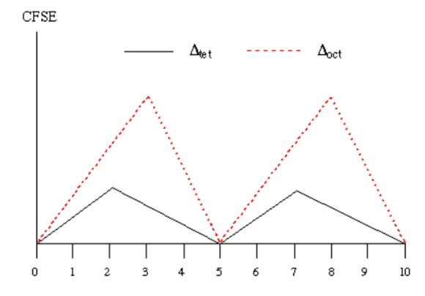
Tetrahedral Complexes
If we do a similar calculation for the other configurations, we can construct a Table of Δ_{o}, Δ_{t} and the difference between them (we'll ignore their signs since we're looking for the difference between them).
Plot these numbers.
Remember: These are CFSE numbers for hypothetical molecules in octahedral and tetrahedral geometry.

Slide 29
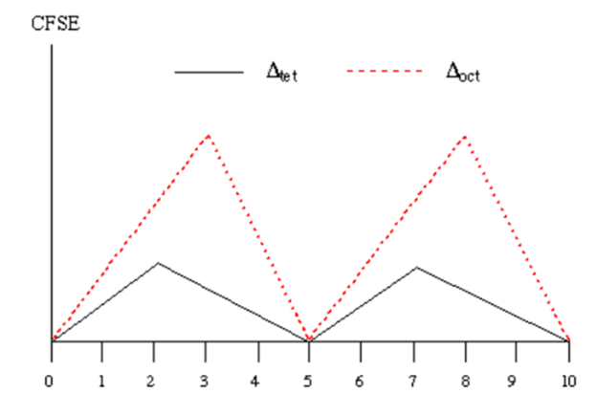
Tetrahedral Complexes
Notice that the Crystal Field Stabilization Energy almost always favors octahedral over tetrahedral in most cases, but the degree of favorability varies with the electronic configuration.
In other words, for d¹ there's only a small gap between the oct and tet lines, whereas at d³ and d⁸ there's a big gap. However, for d⁰, d⁵ high spin and d¹⁰, there is no CFSE difference between octahedral and tetrahedral.
The order of favourability of octahedral vs tetrahedral is:
d³, d⁸ > d⁴, d⁹> d², d⁷ > d¹, d⁶ > d⁰, d⁵, d¹⁰

Slide 30
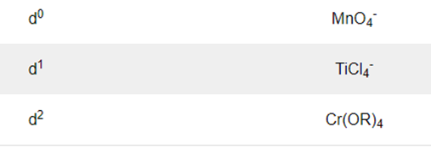
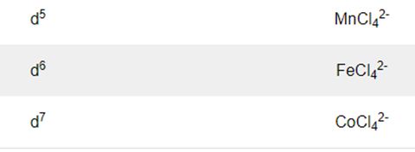
Tetrahedral Complexes: Summary
The following factors favour tetrahedral complexes:
Use large ligands.
Use of metal ions with d⁰, d⁵, d¹⁰ configuration.
Use of weak field ligand with other d^{x} configurations
Examples:

